Slide 1
Added table on pgAdmin
Copy IPL_BALL(id, select * from IPL_BALL
Copy IPL_BALL(id, inning, over, ball, batsman, non_striker, bowler, batsman_runs, extra_runs, total_runs, is_wicket, dismissal_kind, player_dismissed, fielder, extras_type, batting_team, bowling_team)
FROM 'D:\Downloads\IPL Dataset (Final project Sql)\IPL Dataset\csv\IPL_ball.csv'
DELIMITER ','
CSV HEADER;
select * from IPL_BALL
select * from ipl_matches

Slide 2
Aggressive batsmen: High strike rate, faced at least 500 balls. (Remove wide balls, Calculate strike rate = total runs/ball faced) Your priority is to get 2-3 players with high SR who have faced at least 500 balls. To do that you have to make a list of 10 players you want to bid in the auction so that when you try to grab them in the auction you should not pay the amount greater than you have in the purse for a particular player.
Query:
WITH PlayerStats AS (
SELECT
batsman,
COUNT(*) AS balls_faced,
SUM(total_runs) AS total_runs,
count(CASE WHEN extras_type = 'wides' THEN 0 ELSE 1 END) AS valid_balls
FROM IPL_BALL
GROUP BY batsman
),
FilteredPlayerStats AS (
SELECT
*,
total_runs::FLOAT / valid_balls AS strike_rate
FROM PlayerStats
WHERE valid_balls >= 500
)
SELECT
batsman,
balls_faced,
strike_rate
FROM FilteredPlayerStats
ORDER BY strike_rate DESC
LIMIT 10;

Slide 3
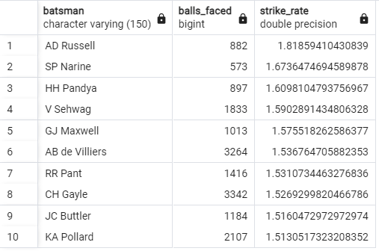
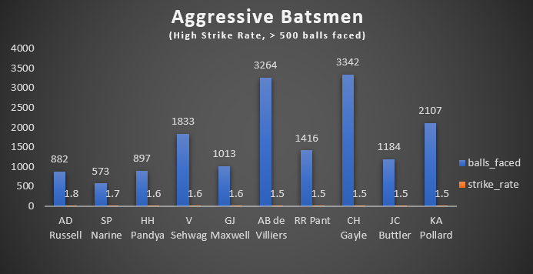

Slide 4
2. Anchor batsmen: High average, played over 2 IPL seasons. (Now you need to get 2-3 players with good averages who have played more than 2 IPL seasons. To do that you have to make a list of 10 players you want to bid in the auction so that when you try to grab them in the auction you should not pay the amount greater than you have in the purse for a particular player. )
Query :
WITH PlayerStats AS (
SELECT
b.batsman,
COUNT(CASE WHEN b.is_wicket = 1 THEN 1 END) AS dismissals,
SUM(b.total_runs) AS total_runs
FROM IPL_BALL b
INNER JOIN IPL_MATCHES m ON b.id = m.id
GROUP BY b.batsman
HAVING COUNT(CASE WHEN b.is_wicket = 1 THEN 1 END) > 0
),
PlayerSeasons AS (
SELECT
b.batsman,
COUNT(DISTINCT m.season) AS seasons_played
FROM IPL_BALL b
INNER JOIN IPL_MATCHES m ON b.id = m.id
GROUP BY b.batsman
HAVING COUNT(DISTINCT m.season) > 2
)
SELECT
pss.batsman,
AVG(ps.total_runs::FLOAT / ps.dismissals) AS avg_runs_per_dismissal,
pss.seasons_played
FROM PlayerStats ps
JOIN PlayerSeasons pss ON ps.batsman = pss.batsman
GROUP BY pss.batsman, pss.seasons_played
ORDER BY AVG(ps.total_runs::FLOAT / ps.dismissals) DESC
LIMIT 10;
Added Season Column:
ALTER TABLE ipl_matches ADD COLUMN season VARCHAR(10);
UPDATE ipl_matches
SET season = EXTRACT(YEAR FROM date);
select * from ipl_matches
select * from ipl_ball

Slide 5
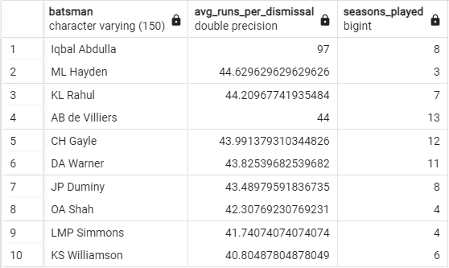
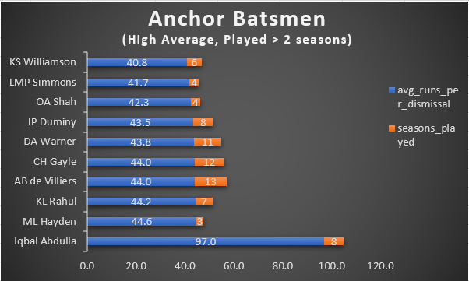

Slide 6
3. Hard Hitters (High Boundary Percentage, Played > 2 seasons). (Now you need to get 2-3 Hard-hitting players who have scored the most runs in boundaries and have played more in the 2 IPL season. To do that you have to make a list of 10 players you want to bid in the auction so that when you try to grab them in the auction you should not pay the amount greater than you have in the purse for a particular player.)
Query:
--Calculate the boundary percentage for each player:
SELECT b.batsman,
b.total_runs,
b.total_boundaries,
CASE
WHEN b.total_runs > 0 THEN (b.total_boundaries * 100.0) / b.total_runs
ELSE 0
END AS boundary_percentage,
b.total_seasons
FROM (
SELECT ib.batsman,
SUM(ib.total_runs) AS total_runs,
SUM(CASE WHEN ib.total_runs IN (4, 6) THEN 1 ELSE 0 END) AS total_boundaries,
COUNT(DISTINCT im.season) AS total_seasons
FROM IPL_BALL ib
INNER JOIN IPL_MATCHES im ON ib.id = im.id
GROUP BY ib.batsman
HAVING COUNT(DISTINCT im.season) > 2
ORDER BY total_boundaries DESC
LIMIT 10
) AS b
ORDER BY boundary_percentage DESC;
SELECT batsman,
SUM(batsman_runs) AS total_runs,
COUNT(CASE WHEN batsman_runs >= 4 THEN 1 ELSE 0 END) AS boundaries,
(COUNT(CASE WHEN batsman_runs >= 4 THEN 1 ELSE 0 END) / SUM(batsman_runs)) * 100 AS boundary_percentage
FROM ipl_ball
WHERE batsman_runs > 0
GROUP BY batsman;
--Calculate the total runs scored by each player:
SELECT batsman, SUM(total_runs) AS total_runs
FROM IPL_BALL
GROUP BY batsman
--Calculate the total boundaries (4s and 6s) scored by each player:
SELECT batsman, SUM(CASE WHEN total_runs IN (4, 6) THEN 1 ELSE 0 END) AS total_boundaries
FROM IPL_BALL
GROUP BY batsman

Slide 7
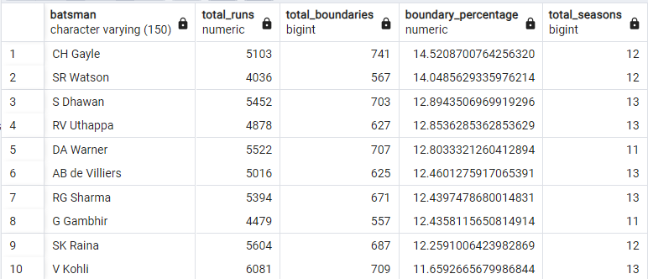
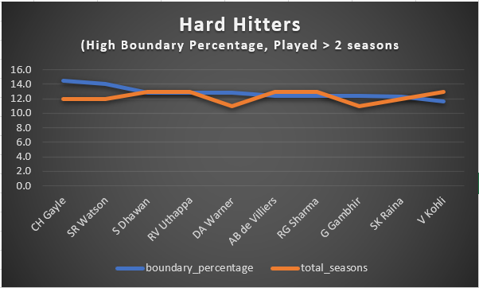

Slide 8
4. Bidding on Bowlers a. Your priority is to get 2-3 bowlers with good economy who have bowled at least 500 balls in the IPL so far. To do that you have to make a list of 10 players you want to bid in the auction so that when you try to grab them in the auction you should not pay the amount greater than you have in the purse for a particular player.
Query:
WITH BowlerStats AS (
SELECT
bowler,
COUNT(*) AS total_balls,
SUM(total_runs) AS total_runs,
COUNT (bowler) / 6 AS total_overs
FROM
IPL_BALL
GROUP BY
bowler
HAVING
COUNT(*) >= 500
)
SELECT
bs.bowler,
bs.total_balls,
bs.total_runs,
bs.total_overs,
(bs.total_runs / bs.total_overs) AS economy
FROM
BowlerStats bs
ORDER BY
economy ASC
LIMIT 10;

Slide 9
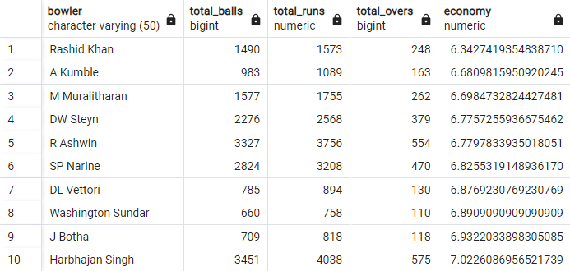
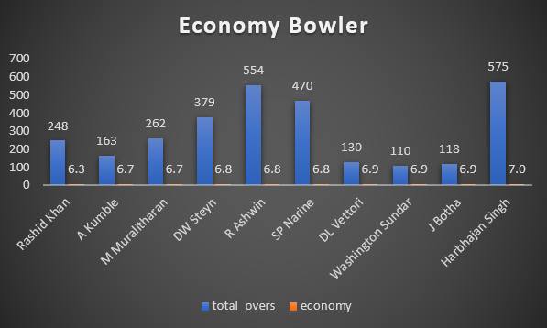

Slide 10
2. Now you need to get 2-3 bowlers with the best strike rate and who have bowled at least 500 balls in IPL so far. To do that you have to make a list of 10 players you want to bid in the auction so that when you try to grab them in the auction you should not pay the amount greater than you have in the purse for a particular player.
Query:
WITH BowlerStats AS (
SELECT
bowler,
COUNT(*) AS total_balls,
SUM(CASE WHEN is_wicket = 1 THEN 1 ELSE 0 END) AS total_wickets
FROM
IPL_BALL
GROUP BY
bowler
HAVING
COUNT(*) >= 500
)
SELECT
bs.bowler,
bs.total_balls,
bs.total_wickets,
(bs.total_balls / NULLIF(bs.total_wickets, 0)) AS strike_rate
FROM
BowlerStats bs
ORDER BY
strike_rate ASC
LIMIT
10;

Slide 11
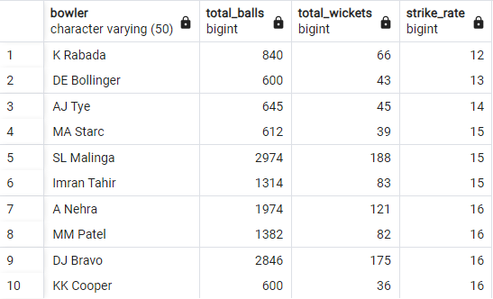
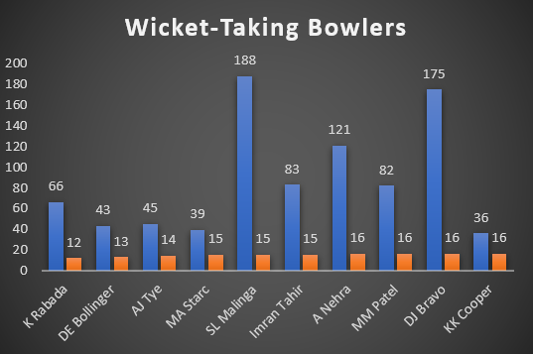

Slide 12
5. All-Rounder Analysis :
Now you need to get 2-3 All-rounders with the best batting as well as bowling strike rate and who have faced at least 500 balls in IPL so far and have bowled a minimum of 300 balls. To do that you have to make a list of 10 players you want to bid in the auction so that when you try to grab them in the auction you should not pay the amount greater than you have in the purse for a particular player.
Query:
all_rounder_stats AS (
SELECT
batsman_stats.batsman,
batsman_stats.balls_faced,
batsman_stats.total_runs,
bowler_stats.balls_bowled,
bowler_stats.total_wickets
FROM
batsman_stats
JOIN
bowler_stats ON batsman_stats.batsman = bowler_stats.bowler
)
SELECT
batsman,
balls_faced,
total_runs,
balls_bowled,
total_wickets,
(total_runs * 100.0) / balls_faced AS batting_strike_rate,
(balls_bowled * 1.0) / total_wickets AS bowling_strike_rate
FROM
all_rounder_stats
ORDER BY
batting_strike_rate DESC,
bowling_strike_rate ASC
LIMIT
10;
WITH batsman_stats AS (
SELECT
batsman,
COUNT(*) AS balls_faced,
SUM(CASE WHEN total_runs IN (4, 6) THEN 1 ELSE 0 END) AS boundaries,
SUM(total_runs) AS total_runs
FROM
IPL_BALL
GROUP BY
batsman
HAVING
COUNT(*) >= 500
),
bowler_stats AS (
SELECT
bowler,
COUNT(*) AS balls_bowled,
SUM(CASE WHEN is_wicket = 1 THEN 1 ELSE 0 END) AS total_wickets
FROM
IPL_BALL
GROUP BY
bowler
HAVING
COUNT(*) >= 300
),

Slide 13
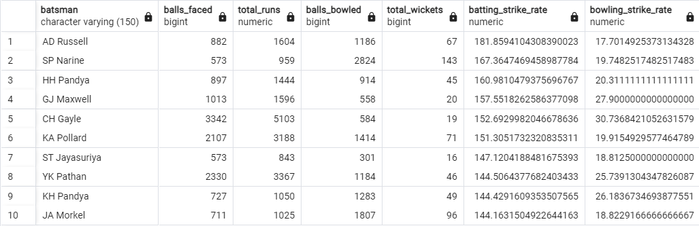
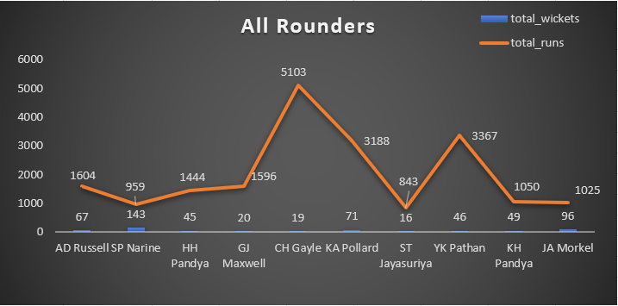

Slide 14
6. Wicketkeeper Analysis
Query:
WITH PlayerStats AS (
SELECT
batsman AS player_name,
COUNT(*) FILTER (WHERE is_wicket = 1) AS dismissals,
COUNT(DISTINCT id) AS matches_played,
SUM(batsman_runs) AS total_runs,
COUNT(*) AS balls_faced
FROM IPL_BALL
GROUP BY batsman
HAVING COUNT(*) > 0 -- Exclude players who have not been dismissed
),
BattingStats AS (
SELECT
player_name,
total_runs,
balls_faced,
total_runs::float / balls_faced AS strike_rate
FROM PlayerStats
WHERE balls_faced > 500 -- Players who have faced at least 500 balls
),
WicketKeepingStats AS (
SELECT
player_name,
dismissals,
matches_played,
dismissals::float / matches_played AS dismissal_rate
FROM PlayerStats
)
SELECT
p.player_name,
COALESCE(bs.strike_rate, 0) AS strike_rate,
COALESCE(ws.dismissal_rate, 0) AS dismissal_rate,
COALESCE(bs.strike_rate, 0) + COALESCE(ws.dismissal_rate, 0) AS total_score
FROM
(SELECT DISTINCT player_name FROM PlayerStats) p
LEFT JOIN BattingStats bs ON p.player_name = bs.player_name
LEFT JOIN WicketKeepingStats ws ON p.player_name = ws.player_name
ORDER BY total_score DESC
LIMIT 2;

Slide 15
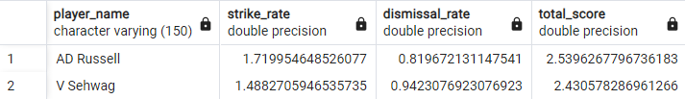
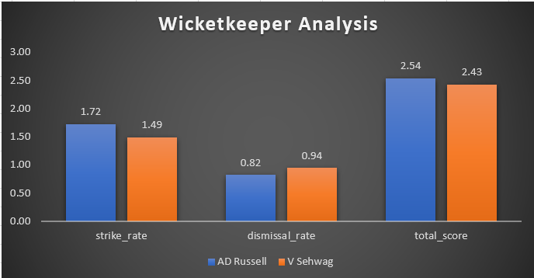

Slide 16

Additional Questions for Final Assessment
Q1. Get the count of cities that have hosted an IPL match.
Query:
SELECT COUNT(DISTINCT city) AS city_count
FROM IPL_matches;
Output Table:

Slide 17
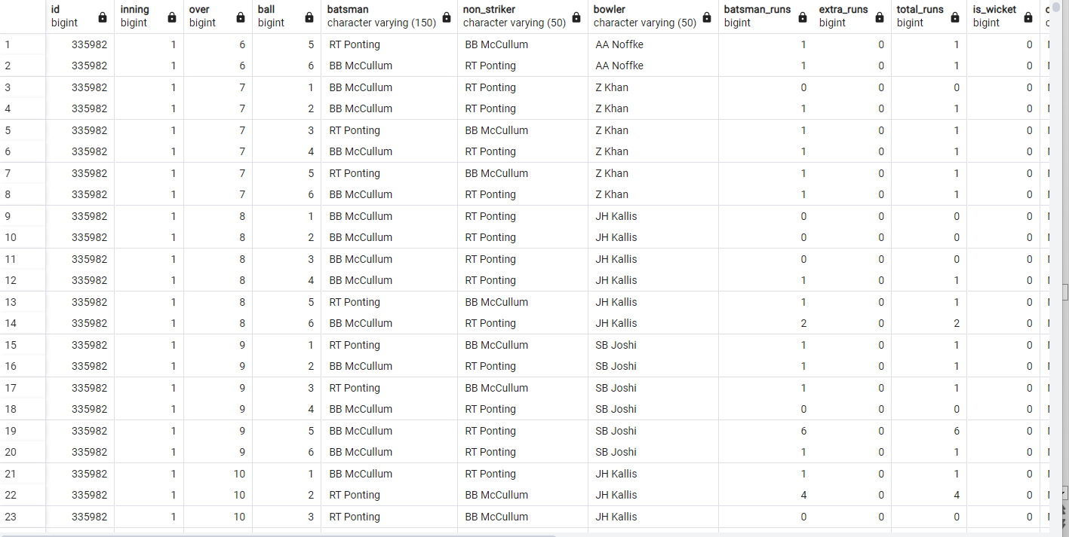
Q2. Create table deliveries_v02 with all the columns of the table ‘deliveries’ and an additional column ball_result containing values boundary, dot, or other depending on the total_run (boundary for >= 4, dot for 0 and other for any other number)(Hint 1 : CASE WHEN statement is used to get condition based results)(Hint 2: To convert the output data of the select statement into a table, you can use a subquery. Create table table_name as [entire select statement].
Sample Screenshot:
Query:
CREATE TABLE deliveries_v02 AS
SELECT *,
CASE
WHEN total_runs >= 4 THEN 'boundary'
WHEN total_runs = 0 THEN 'dot'
ELSE 'other'
END AS ball_result
FROM IPL_BALL;
select * from deliveries_v02

Slide 18
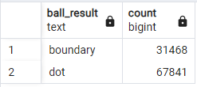
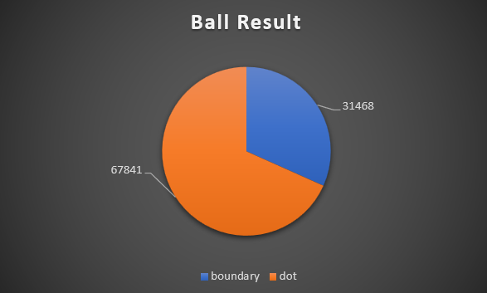
Q3. Write a query to fetch the total number of boundaries and dot balls from the deliveries_v02 table.
Query:
SELECT
ball_result,
COUNT(*) AS count
FROM
deliveries_v02
WHERE
ball_result IN ('boundary', 'dot')
GROUP BY
ball_result;

Slide 19
Q4. Write a query to fetch the total number of boundaries scored by each team from the deliveries_v02 table and order it in descending order of the number of boundaries scored.
Query:
SELECT
batting_team,
COUNT(*) AS total_boundaries
FROM
deliveries_v02
WHERE
ball_result = 'boundary'
GROUP BY
batting_team
ORDER BY
total_boundaries DESC;

Slide 20
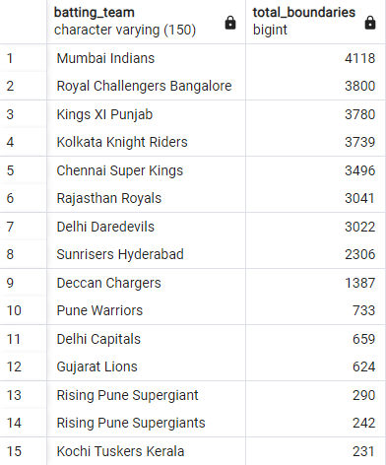
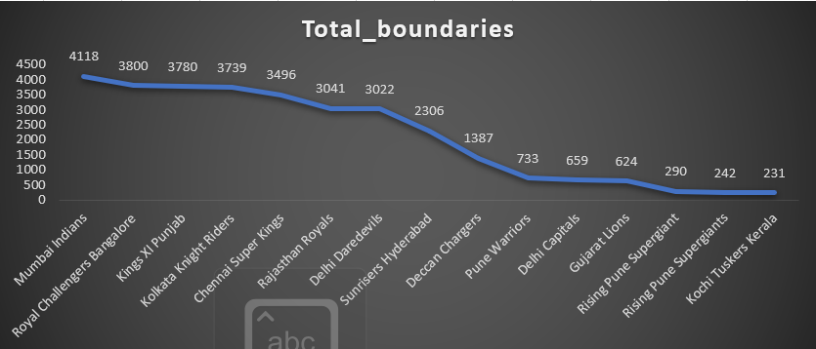

Slide 21
Q5. Write a query to fetch the total number of dot balls bowled by each team and order it in descending order of the total number of dot balls bowled.
Query:
SELECT
bowling_team,
COUNT(*) AS total_dot_balls
FROM
deliveries_v02
WHERE
ball_result = 'dot'
GROUP BY
bowling_team
ORDER BY
total_dot_balls DESC;

Slide 22
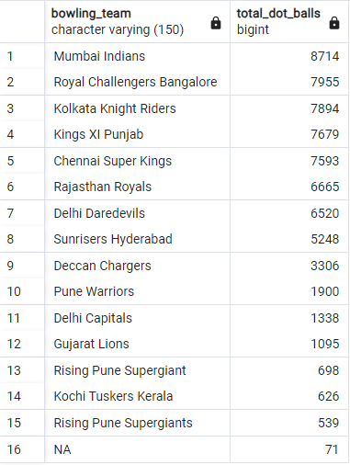
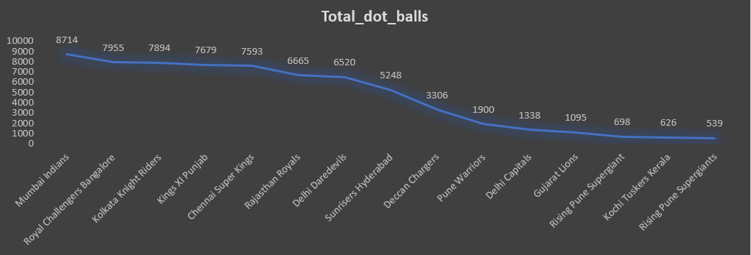

Slide 23
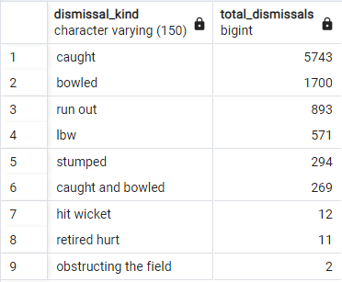
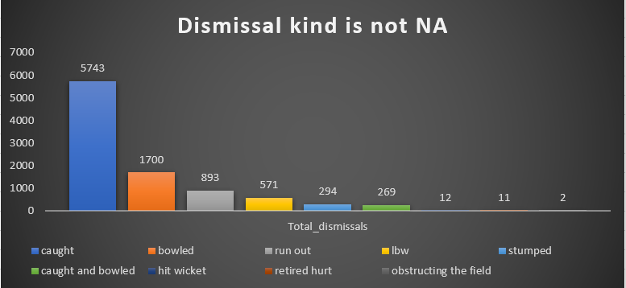
Q6. Write a query to fetch the total number of dismissals by dismissal kinds where the dismissal kind is not NA.
Query:
SELECT
dismissal_kind,
COUNT(*) AS total_dismissals
FROM
deliveries_v02
WHERE
dismissal_kind != 'NA'
GROUP BY
dismissal_kind
ORDER BY
total_dismissals DESC;

Slide 24
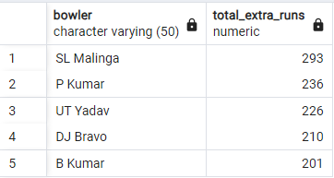
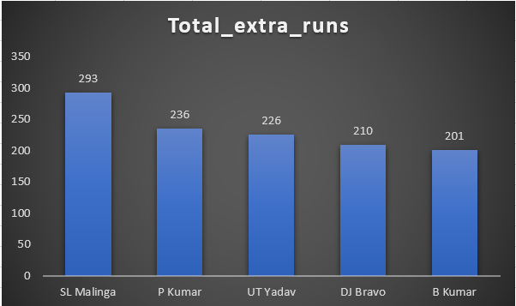
Q7. Write a query to get the top 5 bowlers who conceded maximum extra runs from the deliveries table.
Query:
SELECT
bowler,
SUM(extra_runs) AS total_extra_runs
FROM
deliveries_v02
GROUP BY
bowler
ORDER BY
total_extra_runs DESC
LIMIT 5;

Slide 25
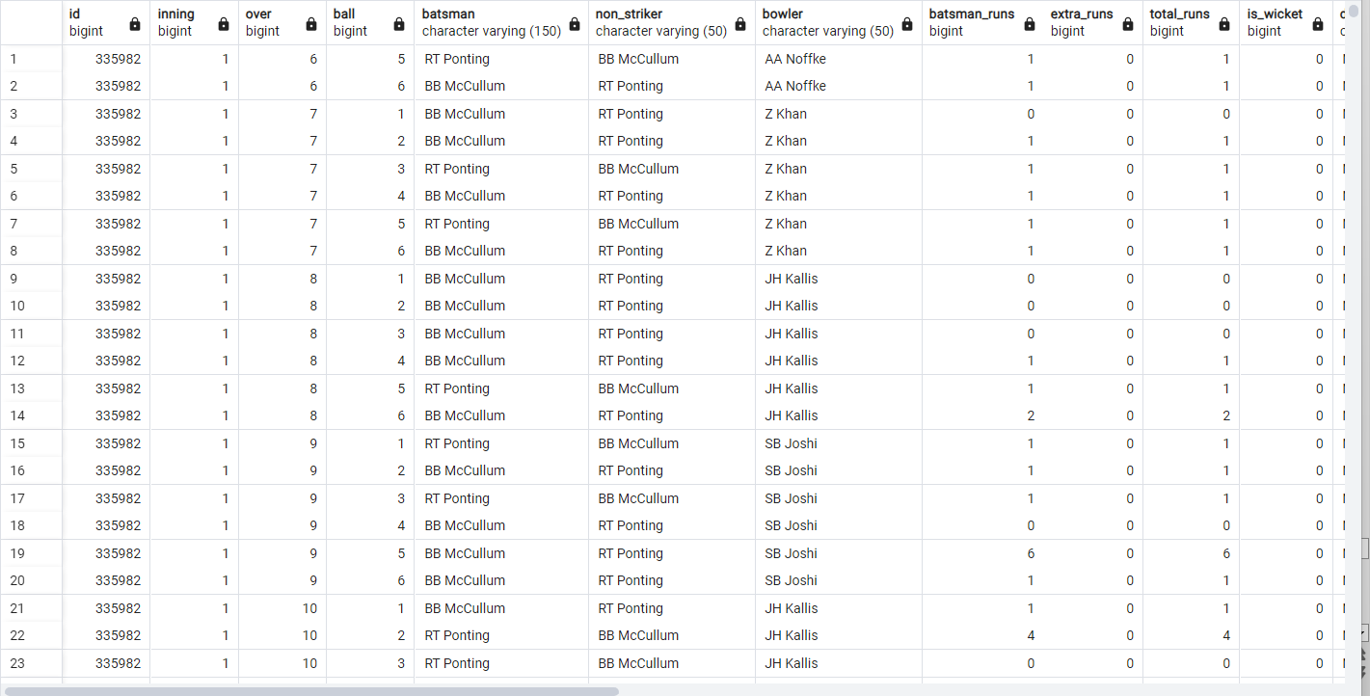
Q8. Write a query to create a table named deliveries_v03 with all the columns of deliveries_v02 table and two additional columns (named venue and match_date) of venue and date from table matches.
Query:
CREATE TABLE deliveries_v03 AS
SELECT d.*, m.venue, m.date AS match_date
FROM deliveries_v02 d
JOIN IPL_matches m ON d.id = m.id;
select * from deliveries_v03
Sample Screenshot:

Slide 26
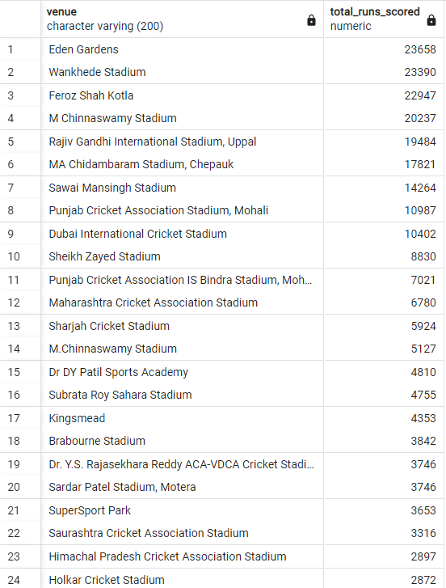
Q9. Write a query to fetch the total runs scored for each venue and order it in the descending order of total runs scored.
Query:
SELECT venue, SUM(total_runs) AS total_runs_scored
FROM deliveries_v03
GROUP BY venue
ORDER BY total_runs_scored DESC;

Slide 27
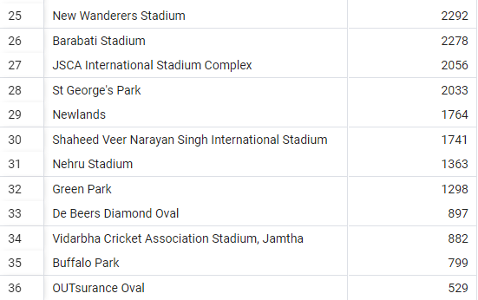
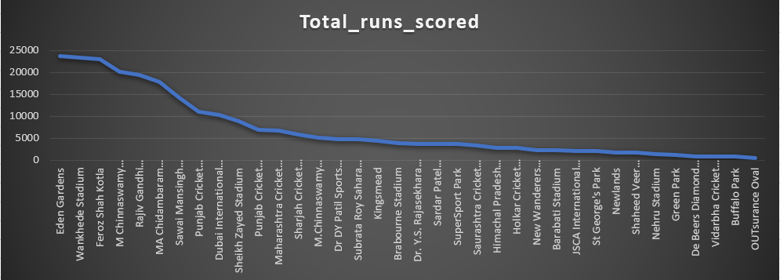

Slide 28
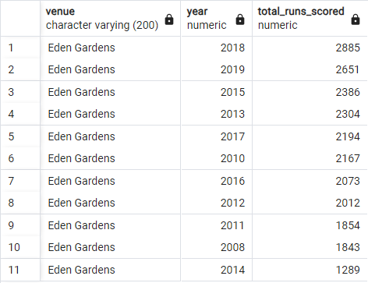
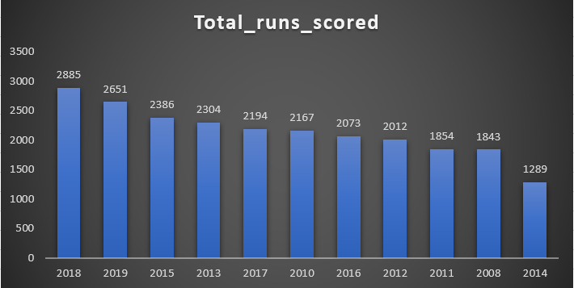
Q10. Write a query to fetch the year-wise total runs scored at Eden Gardens and order it in the descending order of total runs scored.
Query:
SELECT venue, EXTRACT (year FROM match_date) AS year, SUM(total_runs) AS total_runs_scored
FROM deliveries_v03
WHERE venue = 'Eden Gardens'
GROUP BY venue, year
ORDER BY total_runs_scored DESC;

